Slide 1
FAST ENHANCED UNIDENTIFIABLE OBJECT DETECTION USING DEEP LEARNING ALGORITHM
BATCH 11
TEAM MEMBERS :MONISHA V-2017PECCS175
RAMYA S-2017PECCS204
RAMYA S-2017PECCS205
GUIDE DETAILS : Mrs. MAHESWARI M

Slide 2
ABSTRACT
Our framework detects all the objects based on training set provided to it. Main view of this project is to increase the accuracy rate of the detection. It recognize the object even in blur stage or under less brightness.
In recent days the detection of objects is done with FRCNN and YOLO. It has advantages in terms of efficiency i.e ,0.08 second per image, effectiveness and simplicity over existing algorithms.
Over 60-65k images can be trained for detection. This framework can be constructed using deep learning.

Slide 3
LITERATURE SURVEY
Author | Year | Title | Work | Disadvantages
Guoben Chen et al | 2015 | Deep Convolutional Neural Network Based Species Recognition For Wild Animal Monitoring https://ieeexplore.ieee.org/document/8833257 | Supposedly, this paper presents the first attempt to automate wild life monitoring using Deep Convolutional Neural Network on camera trap images In this paper, the performance of DNN is benchmarked against Visual Bag of Words automation method The DNN model was trained on 14346 images and tested upon 9530 images It achieved a better prediction performance over the visual bag of words method | Although, this method provides an automated method to classify wild animals, it didn’t achieve full automation Moreover, the method discussed in the paper heavily depends on training data annotated through other methods including manual efforts. But that could be considered as an intial constraint rather than throughout the whole process

Slide 4
Author | Year | Title | Work | Disadvantages
Gomez et al | 2016 | Animal Identification in low quality camera-trap images using very deep convolutional neural networks and confidence thresholds https://www.researchgate.net/publication/311531986_Animal_Identification_in_Low_Quality_Camera-Trap_Images_Using_Very_Deep_Convolutional_Neural_Networks_and_Confidence_Thresholds | Successfully applied DNNs to distinguishing birds vs mammals in a small dataset of 1572 images and distinguish two mammal sets in a dataset of 2597 images This method achieved better testing accuracy than Chen et al’s. | Even though, this method provides an automated method to classify wild animals with better accuracy, the test dataset used performance evaluation was very small

Slide 5
Author | Year | Title | Works | Demerits
Gomez, Diez G et al | 2018 | Towards automatic wild animal monitoring: Identification of animal species in camera-trap images using very deep CNN https://www.researchgate.net/publication/301840248_Towards_Automatic_Wild_Animal_Monitoring_Identification_of_Animal_Species_in_Camera-trap_Images_using_Very_Deep_Convolutional_Neural_Networks | This paper focuses on evaluating deep convolutional neural networks on the open source Snapshot Serengeti dataset which is much larger dataset with more than 3 million images | The estimated accuracy of their models seem to be only around 57 %. And moreover, this paper only focuses on evaluating 26 species out of 48 species available in the snapshot Serengeti dataset.

Slide 6
Author | Year | Title | Work | Disadvantages
Joseph Redmon, | 2016 | You Only Look Once: Unified, Real-Time Object Detection https://ieeexplore.ieee.org/document/7780460 | A fast and simple approach to detecting real time images was introduced in this paper as You Only Look Once. The model was built to detect images accurately, fast and to differentiate between art and real images. | In comparison with Object detection techniques that came before YOLO, like R-CNN, YOLO introduced a single unified architecture for regression.
Zhimin Mo, Liding Chen, | 2019 | Identification and Detection of Automotive Door Panel Solder Joints based on YOLO https://ieeexplore.ieee.org/document/8833257 | A method for identifying the solder joints of automotive door panels based on YOLO algorithm. | The YOLO algorithm, proposed identifies the position of the solder joints accurately in real time.

Slide 7
PROBLEM STATEMENT
The project "Fast Enhanced Unidentifiable Object Detection Using Deep Learning Algorithms” detects objects efficiently based on YOLO algorithm and FRCNN algorithm and apply the algorithm on image data and video data to detect objects.

Slide 8
TECHNOLOGY STACK
HARDWARE SYSTEM CONFIGURATION:
Processor - Intel Core i7
RAM - 4 GB
Hard Disk - 500 GB
SOFTWARE SYSTEM CONFIGURATION:
Operating System - Windows 7/8/10
Programming Language : Python 3.7

Slide 9
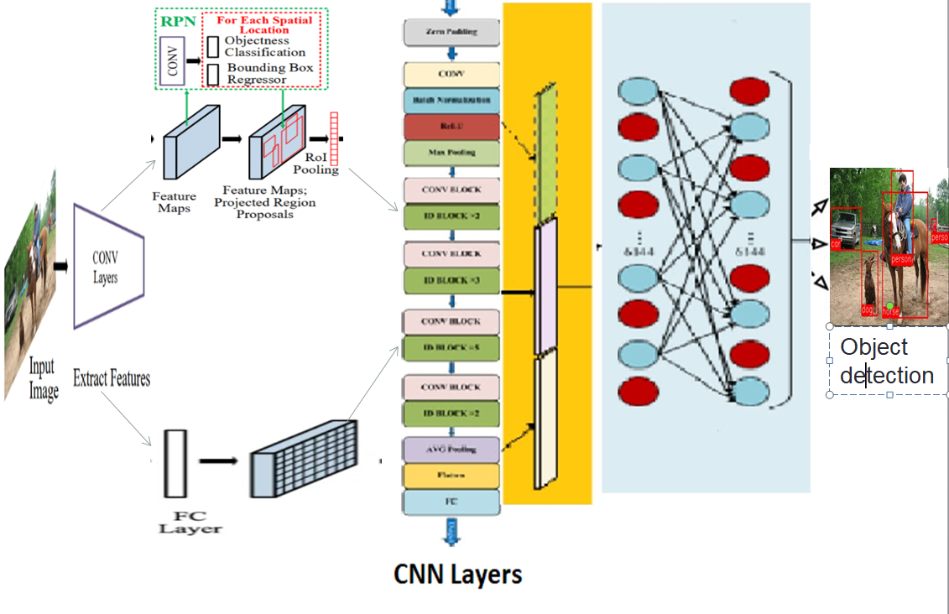
SYSTEM ARCHITECTURE

Slide 10
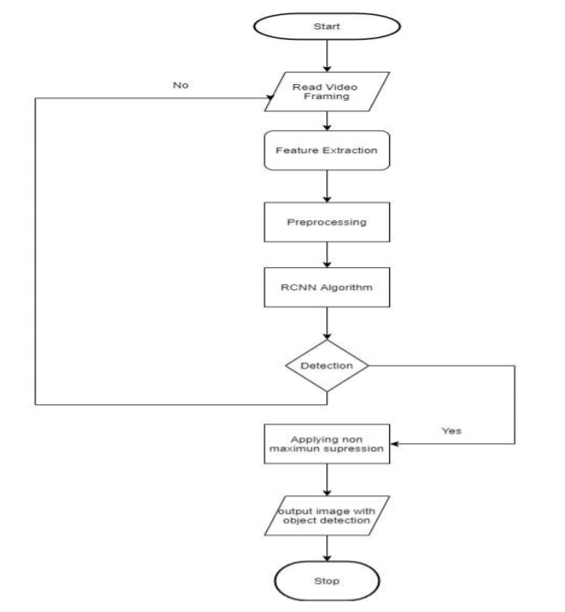
UML DIAGRAM
FLOWCHART

Slide 11
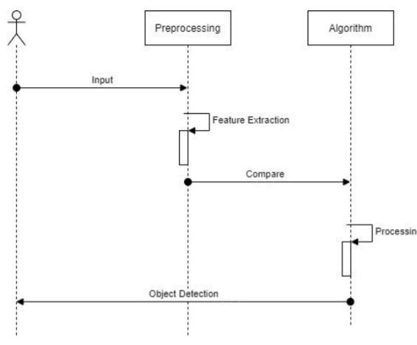
SEQUENCE DIAGRAM

Slide 12
OVERVIEW
Accessing Object and Animal10 Dataset
FCNN Model Training and Development
VGG Architecture
ResNet Architecture
Deploying trained models on test dataset
Performance Evaluation of the two models
Results and Future work recommendation
Image Preprocessing and splitting test and train dataset
Coco dataset

Slide 13
OBJECT DATA COLLECTION
Real time data collected from Coco dataset.
Collection of data is one of the major and most important tasks of any machine learning projects.
Because the input we feed to the algorithms is data. So, the algorithms efficiency and accuracy depends upon the correctness and quality of data collected. So as the data same will be the output.
We collect the data from Coco dataset which is trained and we use that for detecting the objects we feed as input through video or images.

Slide 14
DATA PREPROCESSING
Data collected from various means will be in an unorganized format and there may be lot of null values, in-valid data values and unwanted data.
Cleaning all these data and replacing them with appropriate or approximate data and removing null and missing data and replacing them with some fixed alternate values are the basic steps in pre processing of data.
Even data collected may contain completely garbage values. It may not be in exact format or way that is meant to be.
All such cases must be verified and replaced with alternate values to make data meaning meaningful and useful for further processing. Data must be kept in an organized format.

Slide 15
DATASET
Extracting trained images from COCO Dataset.
The COCO Dataset has 121,408 images. The COCO Dataset has 883,331 object annotations. The COCO Dataset has 80 classes
COCO, short for Common Objects in Context, is large image recognition/classification, object detection, segmentation, and captioning dataset.
Volume: 330K images (200K+ annotated); more than 2M instances in 80 object categories, with 5 captions per image, and 250,000 people with key points.
http://cocodataset.org/#home

Slide 16
ALGORITHMS
YOLO
In this approach, a single neural network divides the image into regions and predicts bounding boxes and probabilities for each region.
The neural network predicts bounding boxes and class probabilities directly from full images in one evaluation. The base YOLO model processes images in real-time at 45 frames per second.
The pre-trained YOLO network weights are provided that can be used directly in any implementation and hence no need to train a model on example images.

Slide 17
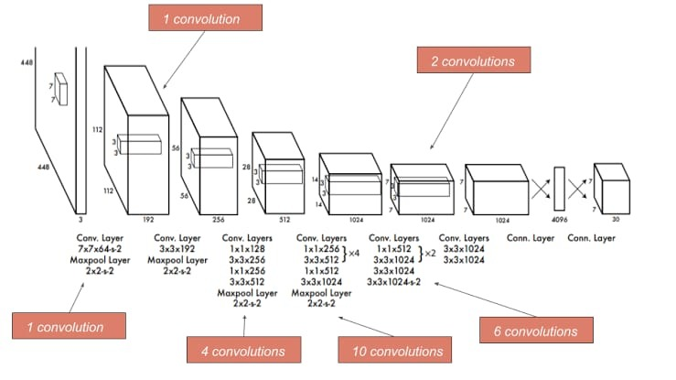

Slide 18
FRCNN
In FRCNN instead of running classification on huge number of regions we pass the image through selective search and select first 2000 region proposal from the result and run classification on that.
In this way instead of classifying huge number of regions we need to just classify first 2000 regions. This makes this algorithm fast compared to previous techniques of object detection.
There are 4 steps in FRCNN. They are as follows :-Pass the image through selective search and generate region proposal. Calculate IOU (intersection over union) on proposed region with ground truth data and add label to the proposed regions. Do transfer learning using the proposed regions with the labels.
Pass the test image to selective search and then pass the first 2000 proposed regions from the trained model and predict the class of those regions.

Slide 19
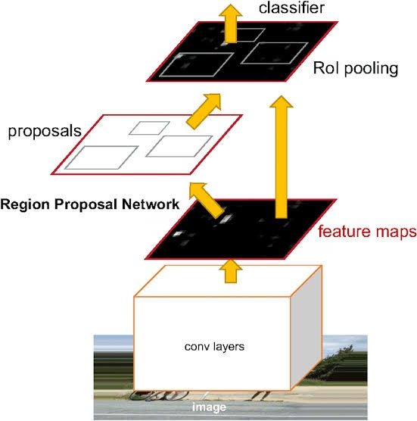

Slide 20
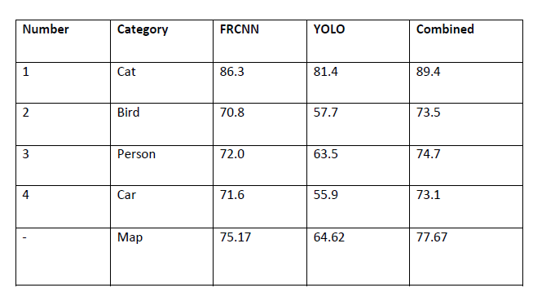
PERFORMANCE ANALYSIS
Table1.Comparison of accuracy(%) between FRCNN, YOLO and combination of both in COCO dataset. This table shows that performance is better when we combine both the algorithms for detecting an object and we get a gain of 2.5.

Slide 21
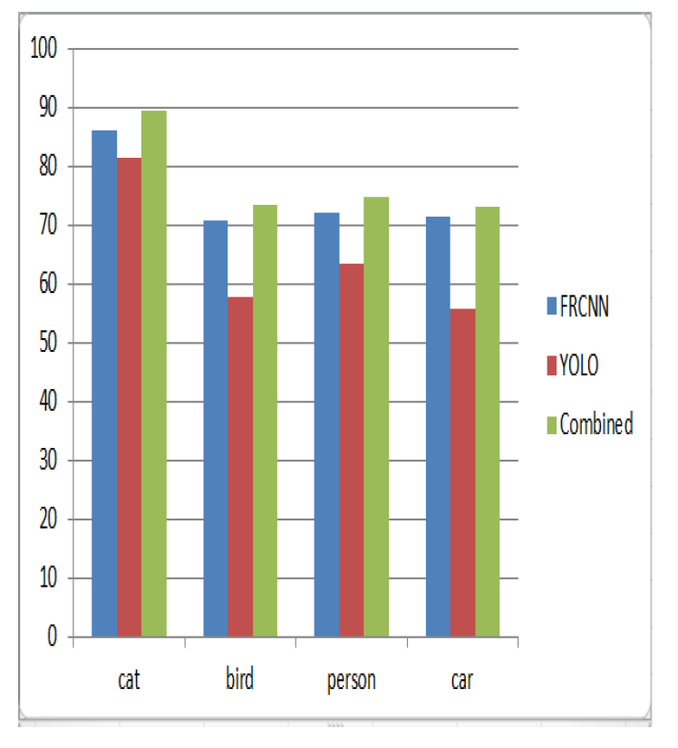
Comparison of the performance among Fast RCNN , YOLO and Fast RCNN+YOLO in COCO dataset.

Slide 22
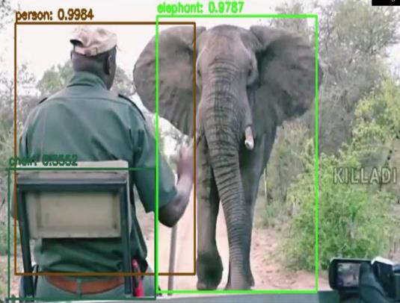
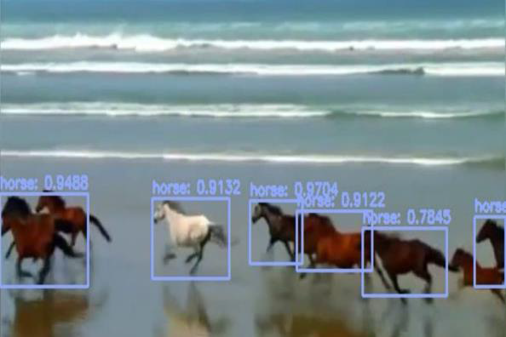
SCREEN SHOTS

Slide 23
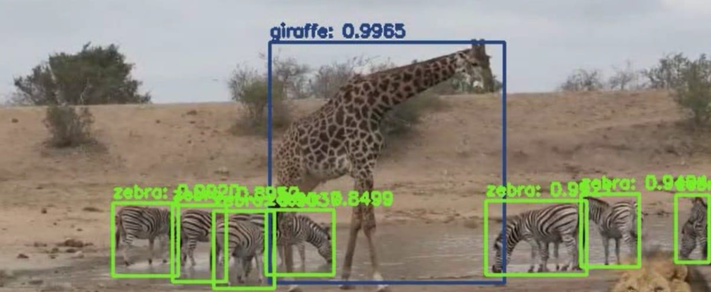
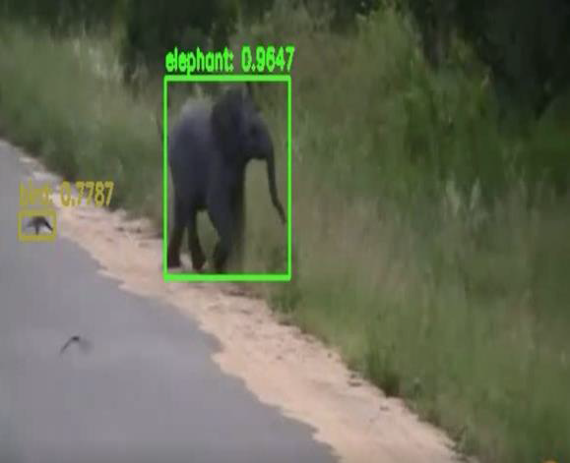

Slide 24
CONCLUSION
Based on experimental results we are able to detect object more precisely and identify the objects individually with exact location of an object in the picture in x ,y axis. This paper also provide experimental results on different methods for object detection and identification and compares each method for their efficiencies.
In Future, it will be enhanced by achieving alert signals by detecting the objects.

Slide 25
REFERENCES
[1] P. F. Felzenszwalb, R. B. Girshick, D. Mcallester, and D. Ramanan, “Object detection with discriminatively trained part-based models,” IEEE Trans. Pattern Anal. Mach. Intell., vol. 32, no. 9, p. 1627, 2010.
[2] K. K. Sung and T. Poggio, “Example-based learning for view-based human face detection,” IEEE Trans. Pattern Anal. Mach. Intell., vol. 20, no. 1, pp. 39–51, 2002.
[3] C. Wojek, P. Dollar, B. Schiele, and P. Perona, “Pedestrian detection: An evaluation of the state of the art,” IEEE Trans. Pattern Anal. Mach. Intell., vol. 34, no. 4, p. 743, 2012.
[4] H. Kobatake and Y. Yoshinaga, “Detection of spicules on mammogram based on skeleton analysis.” IEEE Trans. Med. Imag., vol. 15, no. 3, pp. 235–245, 1996.
[5] Y. Jia, E. Shelhamer, J. Donahue, S. Karayev, J. Long, R. Girshick, S. Guadarrama, and T. Darrell, “Caffe: Convolutional architecture for fast feature embedding,” in ACM MM, 2014.
[6] A. Krizhevsky, I. Sutskever, and G. E. Hinton, “Imagenet classification with deep convolutional neural networks,” in NIPS, 2012.
[7] Z. Cao, T. Simon, S.-E. Wei, and Y. Sheikh, “Realtime multi-person 2d pose estimation using part affinity fields,” in CVPR, 2017.

Slide 26
[8] Z. Yang and R. Nevatia, “A multi-scale cascade fully convolutional network face detector,” in ICPR, 2016.
[9] C. Chen, A. Seff, A. L. Kornhauser, and J. Xiao, “Deepdriving: Learning affordance for direct perception in autonomous driving,” in ICCV, 2015.
[10] X. Chen, H. Ma, J. Wan, B. Li, and T. Xia, “Multi-view
[11] A. Dundar, J. Jin, B. Martini, and E. Culurciello, “Embedded streaming deep neural networks accelerator with applications,” IEEE Trans. Neural Netw. & Learning Syst., vol. 28, no. 7, pp. 1572–1583, 2017.
[12] R. J. Cintra, S. Duffner, C. Garcia, and A. Leite, “Low-complexity approximate convolutional neural networks,” IEEE Trans. Neural Netw. & Learning Syst., vol. PP, no. 99, pp. 1–12, 2018.
[13] S. H. Khan, M. Hayat, M. Bennamoun, F. A. Sohel, and R. Togneri, “Cost-sensitive learning of deep feature representations from imbalanced data.” IEEE Trans. Neural Netw. & Learning Syst., vol. PP, no. 99, pp. 1–15, 2017.
[14] A. Stuhlsatz, J. Lippel, and T. Zielke, “Feature extraction with deep neural networks by a generalized discriminant analysis.” IEEE Trans. Neural Netw. & Learning Syst., vol. 23, no. 4, pp. 596–608, 2012.
[15] R. Girshick, J. Donahue, T. Darrell, and J. Malik, “Rich feature hierarchies for accurate object detection and semantic segmentation,” in CVPR, 2014.

